Slide 1
Volumetric Clouds
Ricky Arietta
CIS 565
Fall 2013

Slide 2
Project Outline
Project will (hopefully) include three parts:
User interface for creating proxy geometry
Cloud voxel generator and ray marching renderer
Simulation of realistic cloud dynamics

Slide 3
Part 1: User Interface
Users will be able to place simple spheres/cubes in 3D space to indicate rough form of clouds.
Possibly indicate other parameters of cloud noise or cloud dynamics

Slide 4
Part 2: Ray Marching Renderer
Written entirely in CUDA
Adapted from ray tracing project / CIS 560 Project 1

Slide 5
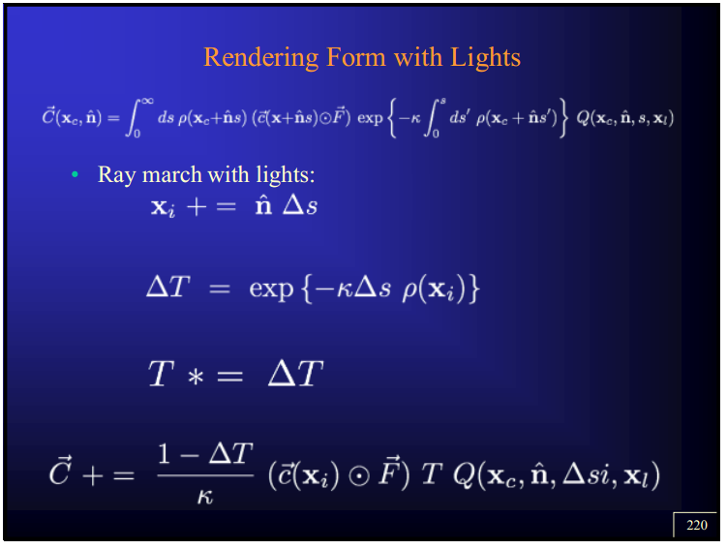
Part 2: Ray Marching Renderer

Slide 6

Part 3: Cloud Dynamics
Simulation of cloud dynamics and light scattering
Based on Mark Harris’ work (images seen left) entitled Simulation of Cloud Dynamics on Graphics Hardware
Harris’ work is in 2D, hope to extend to 3D

Slide 7
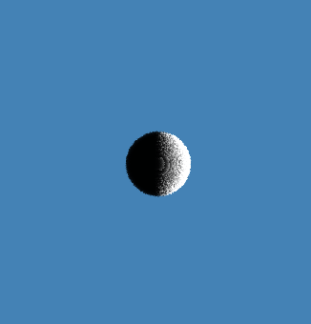
Alpha Demo (Very Basic Rendering)

